Slide 1
Java BufferedWritter class
The Java BufferedWriter class (java.io.BufferedWriter) provides buffering to Writer instances. Buffering can speed up IO quite a bit. Rather than write one character at a time to the network or disk, the BufferedWriter writes a larger block at a time. This is typically much faster, especially for disk access and larger data amounts.
Writes text to a character-output stream, buffering characters so as to provide for the efficient writing of single characters, arrays, and strings.
In general, a Writer sends its output immediately to the underlying character or byte stream. Unless prompt output is required, it is advisable to wrap a BufferedWriter around any Writer whose write() operations may be costly, such as FileWriters and OutputStreamWriters.
FileWritter
Buffer
BufferedWritter
uses
myoutputfile.txt
Java Application
Write
Write
Peter is going to India

Slide 2
Java BufferedWritter class
To add buffering to a Writer simply wrap it in a Java BufferedWriter.
This example creates a BufferedWriter which writes characters to a FileWriter
BufferedWriter bufferedWriter = new BufferedWriter(new FileWriter("c:\\data\\myoutputfile.txt"));

Slide 3
Java BufferedWritter class
You can set the buffer size to use internally by the Java BufferedWriter. You provide the size as a constructor parameter, like below.
This example sets the internal buffer of the BufferedWriter to 8 KB. It is best to use buffer sizes that are multiples of 1024 bytes. That works best with most built-in buffering in hard disks etc.
Except for adding buffering to your output streams, BufferedWriter behaves pretty much like a Writer. The BufferedWriter adds one extra method though: The newLine() method which can write a new-line character to the underlying Writer. In addition, you may need to call flush() if you need to be absolutely sure that the characters written until now is flushed out of the buffer and onto the network or disk.
When you are finished writing characters to the Java BufferedWriter you should remember to close it. Closing a BufferedWriter will also close the Writer instance to which the BufferedWriter is writing.Closing a BufferedWriter is done by calling its close() method
int bufferSize = 8 * 1024;
BufferedWriter bufferedWriter = new BufferedWriter( new FileWriter("c:\\data\\myoutputfile.txt"), bufferSize);
bufferedWriter.close();

Slide 4
Java BufferedWritter class
Writer
BufferedWriter

Slide 5
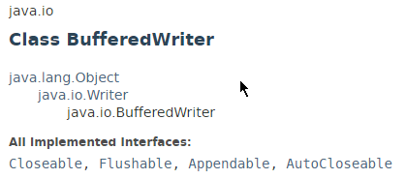
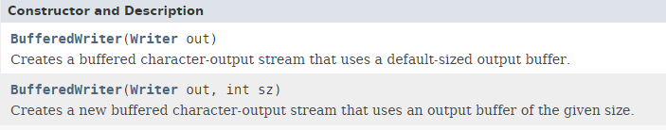
Java BufferedWritter class

Slide 6
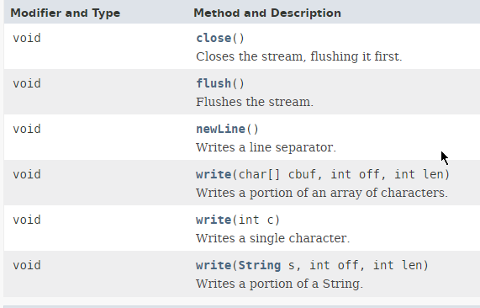
Java BufferedWritter class

Slide 7
Java BufferedReader class
https://docs.oracle.com/javase/8/docs/api/index.html?java/io/BufferedWriter.html

